Slide 1
Property Finder
Daniel, Mark, Lucis

Slide 2
Executive Summary
Team DML developed a working prototype application, ‘Property Finder’ for customers to Rent or Buy property, utilising cryptocurrency accepted transactions

Slide 3
Concept
Concept: Property Finder
Reason for developing:
Simply pay with Cryptocurrency without additional third party involvements
Less fees
Secure user data (no third party data sales)
Additional goals: Connecting various learning modules together learnt in course
Breakdown of tasks and roles
Administrative & Data gathering : All
Pyviz : Mark
Remix : Daniel
Streamlit : Lucis

Slide 4
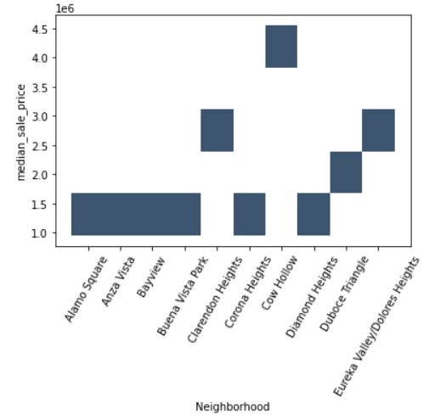
PyViz Charts and Data

Slide 5
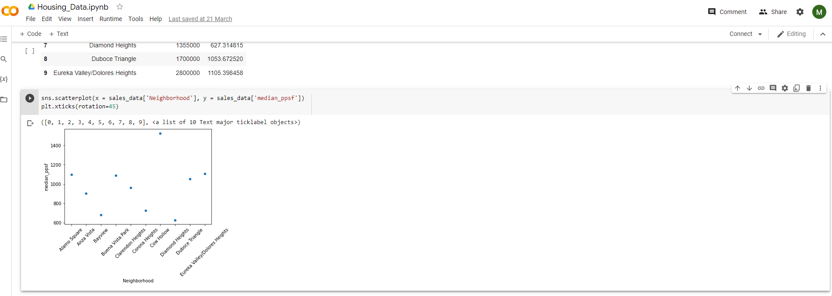
PyViz Charts and Data (Google Collab)

Slide 6
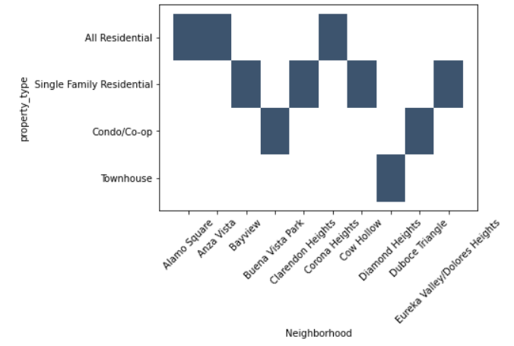
PyViz Charts and Data

Slide 7
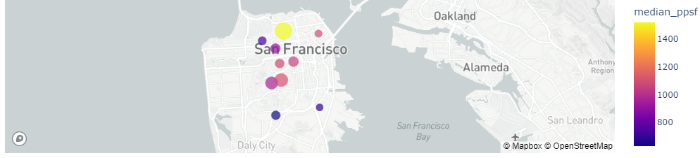
PyViz Charts and Data

Slide 8
Data Techniques
Description of data source.
Variety of Real Estate Databases, such as private (Zillow) and public government sources. Most databases were in CSV form but however had to deal with a new type of file for larger databases called a GZ file which an unzipper was needed.
Reasoning for data selection.
These data sources had the most accurate information aswell as a large variety of it information. Was able to
Collection, exploration and cleaning process.
Longest part was finding and filtering through the numerous excel, csv and gz zip files to find relevant data for the project. Once finding relevant data, converting GZ files (very large zip files, most of them 1gb +) to CSV files was the next step.
Cleaning the CSV files to find relevant data was the next part - this was the largest books I've cleaned, some books having 500,000 + rows.

Slide 9
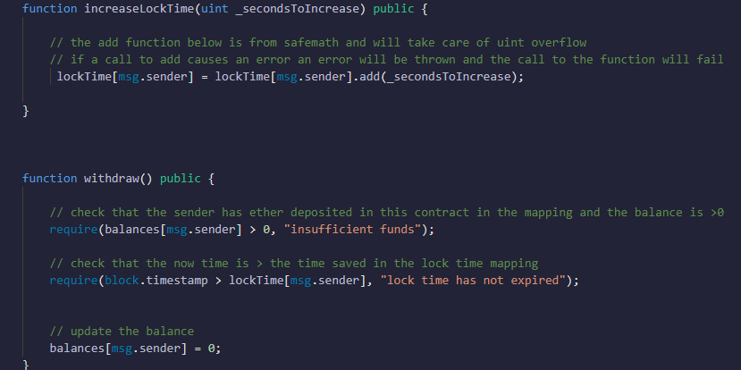
Remix/Solidity
Use of Remix IDE
Use of a timelock with the withdraw function
This is to improve security
If time allowed would have used the
Ownable library, which helps with exploitation
and owner attacks

Slide 10
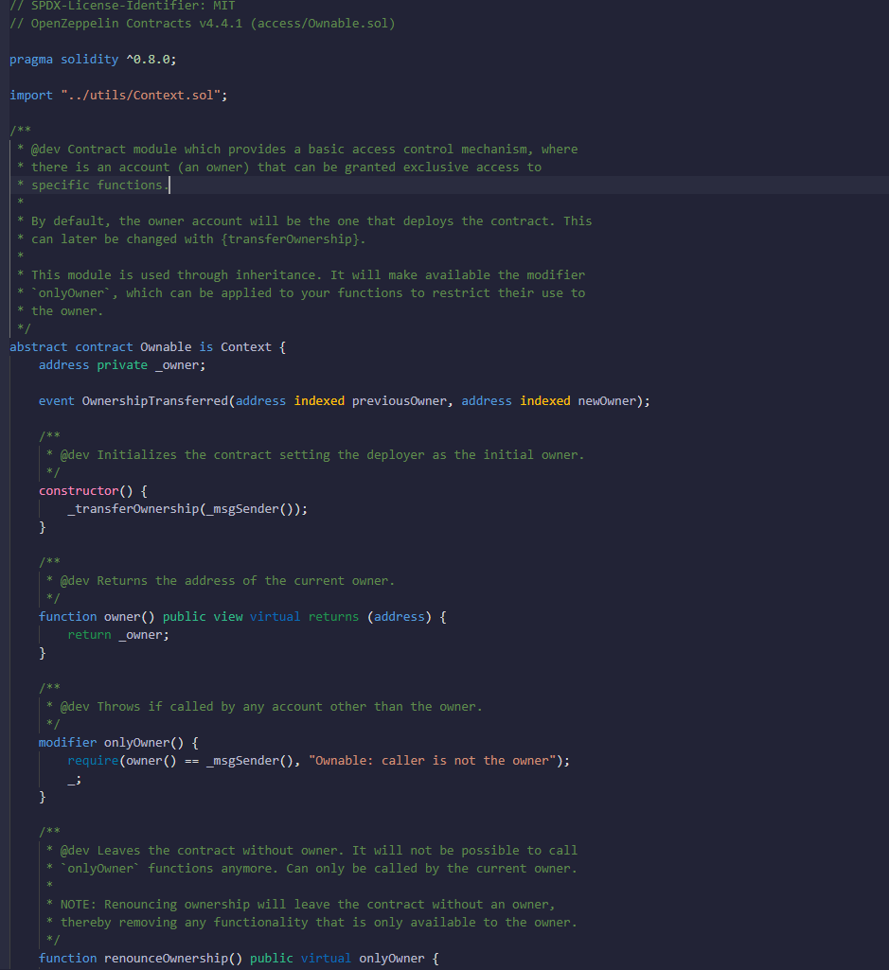

Slide 11
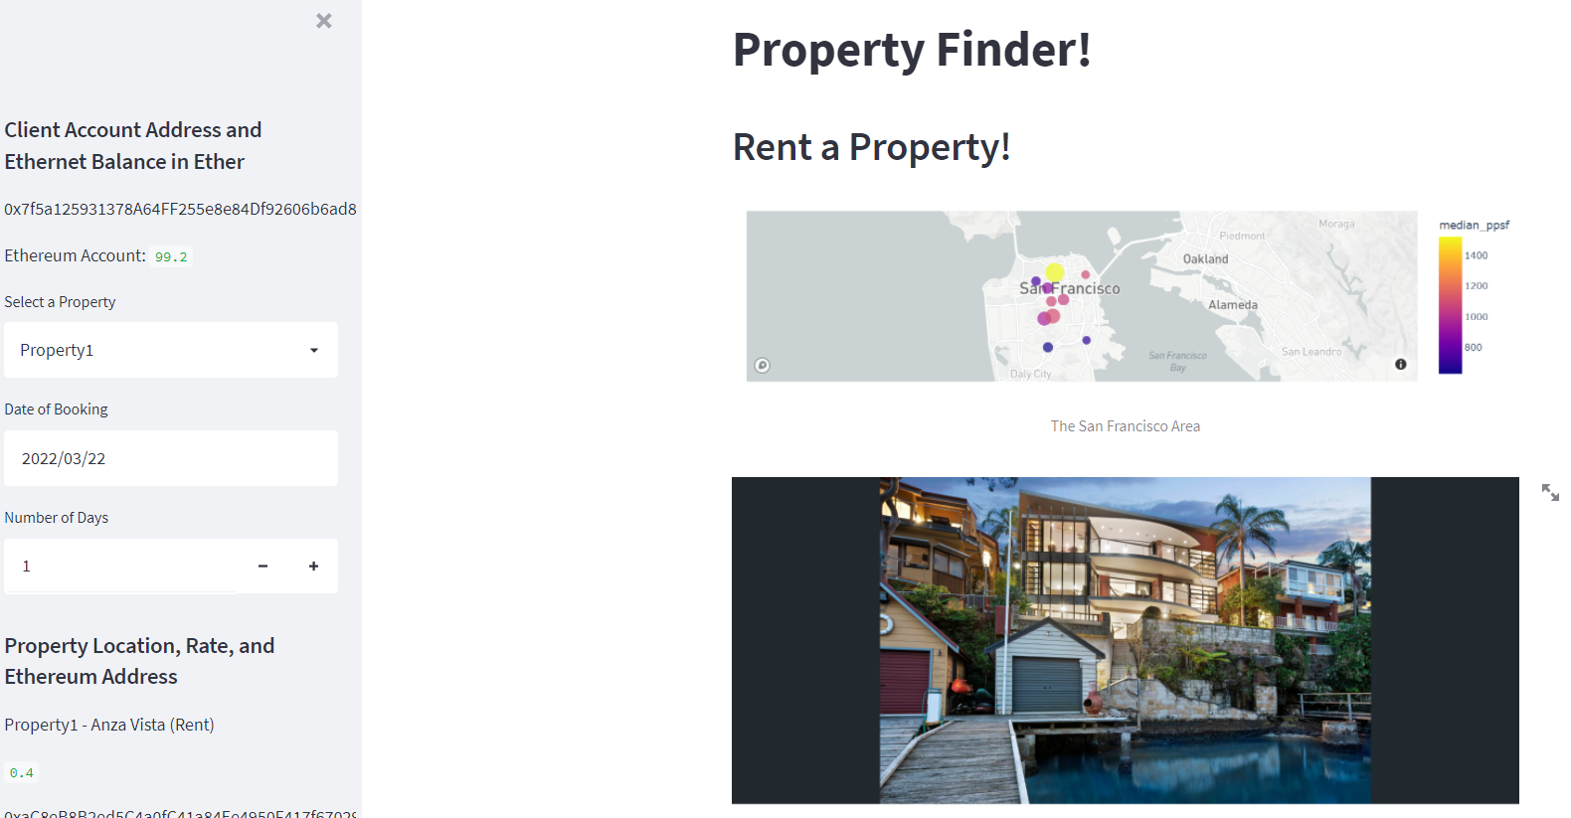
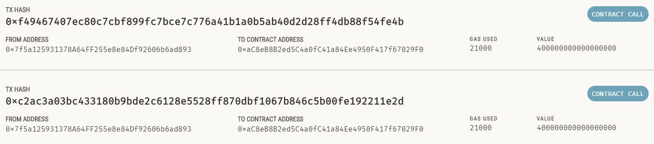
Streamlit
Technologies and methods Utilised:
Additional Streamlit modules
Ganache
ABI connecting code
testing/troubleshooting
Successes:
Completed Initial working prototype

Slide 12
Demo

Slide 13
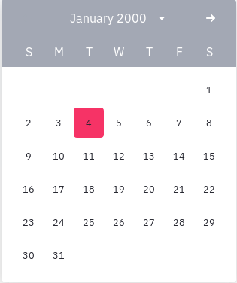
Challenges
Next steps
Streamlit date time slider wouldn’t work
Could only add one date through calendar.
Only alternative was to simply add days through counter
Increase performance of user interface
Additional functionality for user experience

Slide 14
Links
Deployed application.
GitHub repo.

